Slide 1


A card game built on the blockchain
Stogiannidis Ilias - Marios 3180178
Diamantopoulos – Pantaleon Odyssefs 3180049
BSC Thesis Presentation
Athens University of Economics and Business
School of Information Sciences and Technology
Department of Informatics
Led by Professor George C. Polyzos and PhD Candidate Iakovos Pittaras

Slide 2
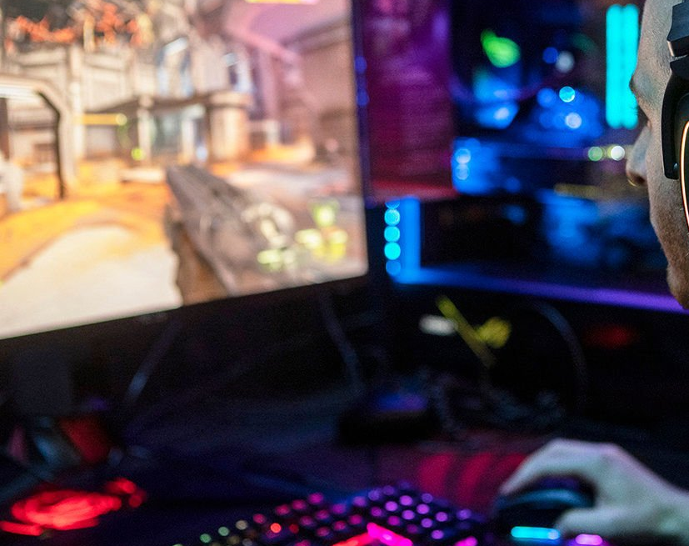
How did we come up with the idea?

Slide 3

Our first contact with Blockchain technology
In a discussion, Prof. Polyzos shared with us his current interests and work, that led us to learn more about Blockchains, their use and their application
We were also invited to the MMLab facilities and participate in a summer program led by Prof. Polyzos that brought us closer to many new technologies including Blockchains

Slide 4
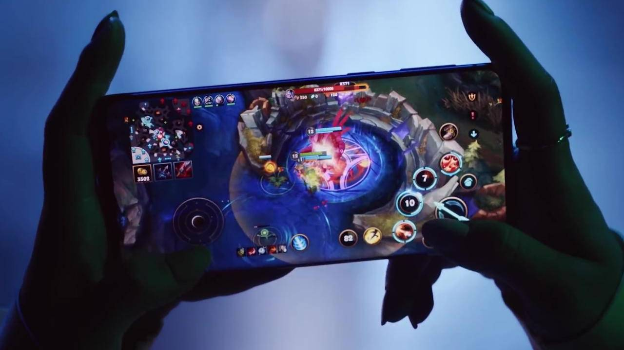
Most video games that have been initially released for PCs have made their way in the mobile gaming area
Games such as:
League Of Legends
Hearthstone
Legends of Runeterra

Slide 5
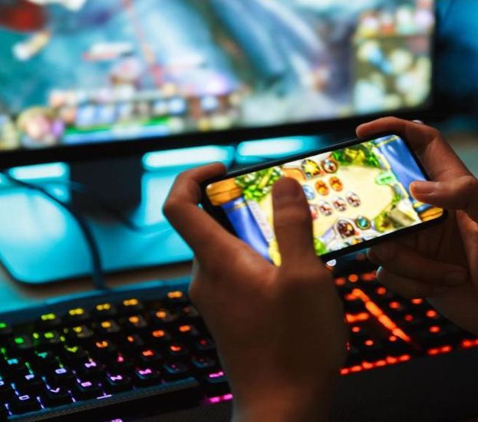
We are huge fans of mobile gaming
We value the Blockchain technology and its advantages
We noticed the lack of mobile games utilizing this technology in the market
So, we decided to create one!

Slide 6
Project Overview

Slide 7
But first, what is a card game ?
It is an 1vs1 strategy game
Every player brings to the fight their own deck of cards
Every deck contains unique combinations of cards
In order to win one player needs to eliminate the opponent’s life points(?how: by using his own cards)

Slide 8
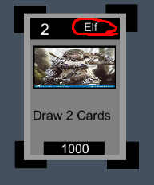
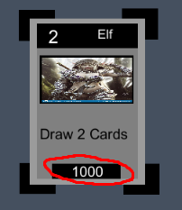
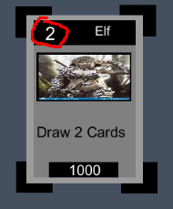
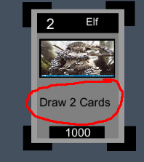
The basis of every card game: Cards
All cards have:
A name
A mana cost
An effect
Power points

Slide 9
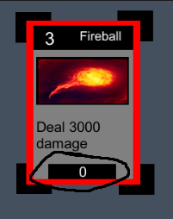
There are two types of cards
Monster cards:
When summoned, monster cards remain
on the field
Spell cards:
When summoned, a spell card will use
its effect and the it will be destroyed

Slide 10
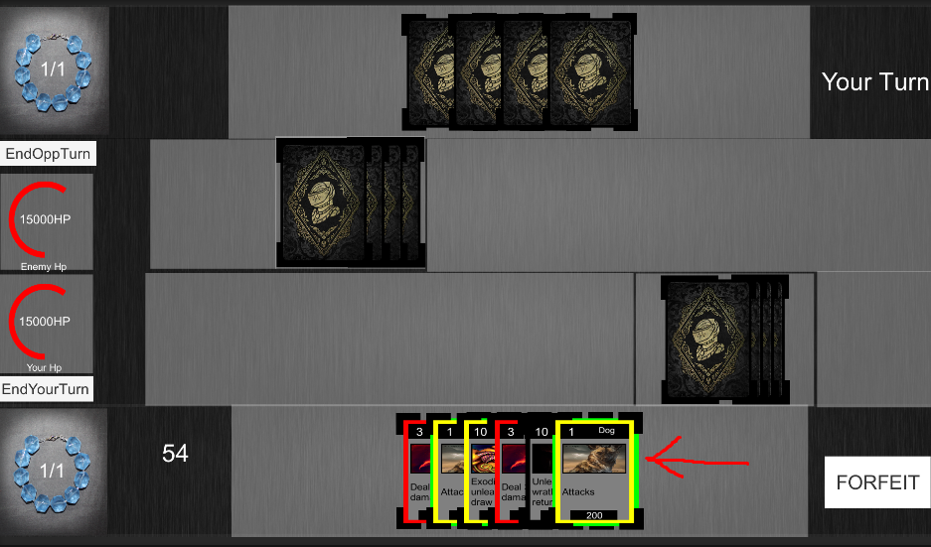
The actual game
A player must create a deck consisting of 40 cards in order to face of an AI opponent
The area the arrow points to is the player’s hand
Each player starts the game with one mana point that gradually increases
Each player starts with 15000 life points
When a card can be summoned the border is glowing green

Slide 11
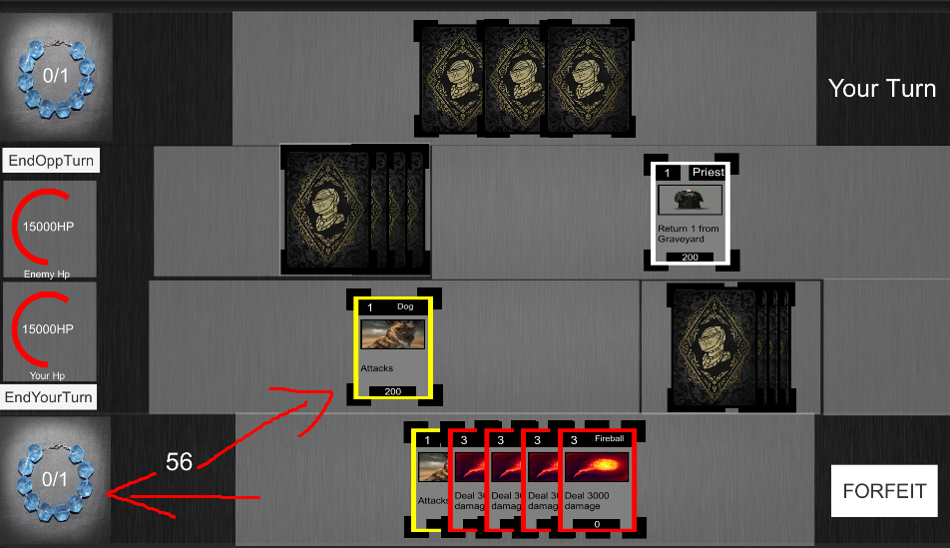
The actual game
Card summoning reduces the available mana point each player has
The card can either attack opponent’s monster or directly their life points
Whoever player’s life points drop to zero, they lose

Slide 12

Analyzing the Components

Slide 13
Unity
The game aspect of the project was created using the Unity Engine
It was developed using C#
The project is embedded in the android application
It communicates with the JS server using the Socket IO library

Slide 14
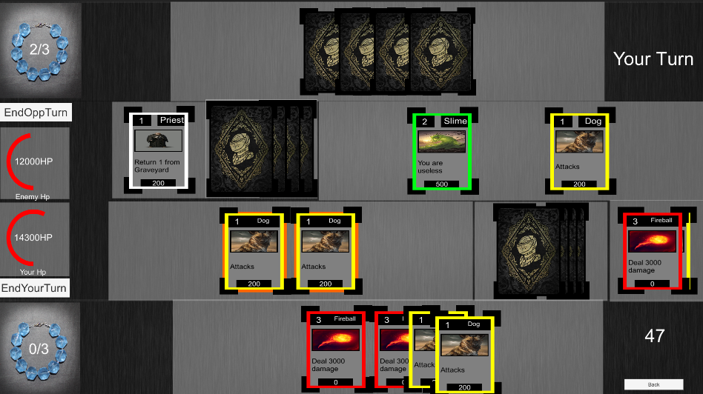
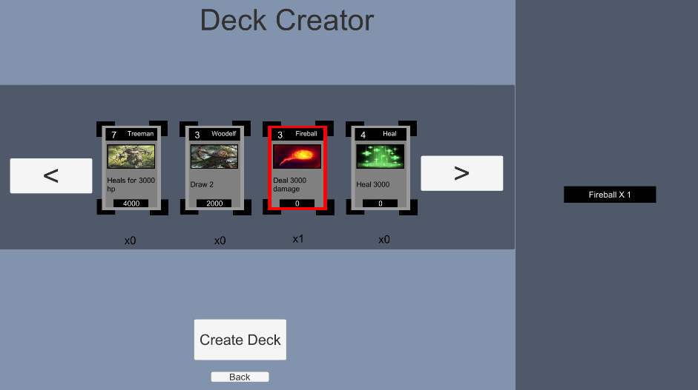
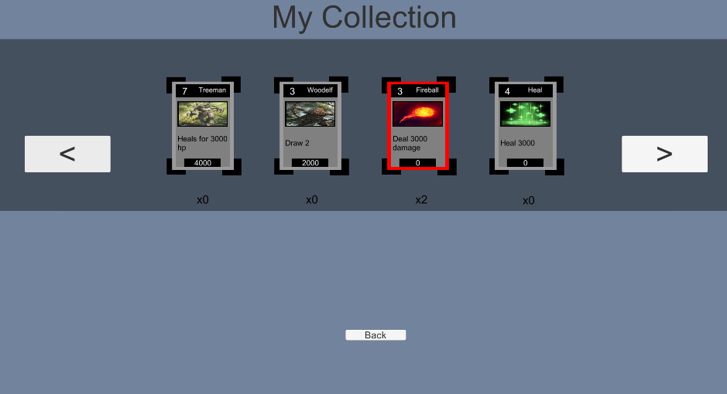
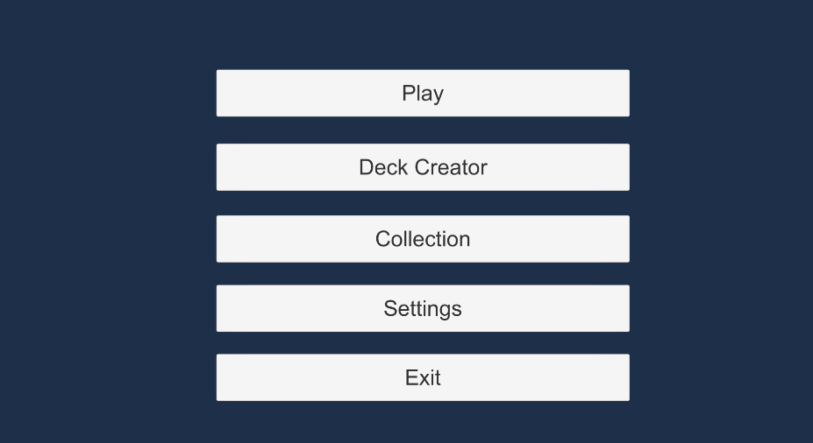
Screenshots

Slide 15
Android Application
This aspect of the project is developed using Android Studio
It is written in Java
The app offers a log in screen for the user
It sends to the Java server the information needed to connect to the user’s wallet

Slide 16
Screenshots

Slide 17
Servers
The Java server forwards the user information to the JS server
The JS server has two functions:
To establish a connection with the Ethereum Blockchain and retrieve information from it
To send the information retrieved to the game

Slide 18
Ethereum Blockchain
This aspect of the project was developed using solidity and the Remix IDE
As a wallet provider we use MetaMask
We use Infura and the Rinkeby network for testing
Each contract offers an API for the JS server to retrieve any information needed
There are two types of token standards that were used: ERC-20, ERC-721

Slide 19
The difference between cards
ERC-20 cards represent a class of cards that consist multiple times in the game
ERC-721 cards represent one individual card that consists only once in the game

Slide 20
The advantages of token usage
Cards and card classes are created once by the creators
They cannot be duplicated from players who want to cheat
They offer a play-to-earn mentality to the game

Slide 21

Ethereum Blockchain Advantages
Data coordination (Decentralized System)
Provides safety to transactions
Rapid contract deployment
Access in test networks
Finality
Tokenization of assets (e.g. Cards and other game objects)
Has its own programming language that is being executed on the Blockchain and allows development and execution of Dapps

Slide 22
Evaluation of gas cost
Gas costs are being paid only when transferring cards
Gas costs are so low the they can be easily paid

Slide 23
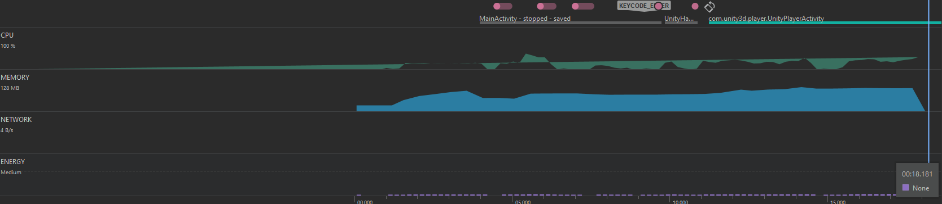
Evaluation of the App
The app opens the game
Communicates with the servers
Servers read from the blockchain the necessary information and transfers it to the app
All of this happens in an average of 18 seconds

Slide 24
Future Improvements
Multiplayer
Marketplace
New cards
User information Database
UI/UX improvements
New AI opponents
Reward System

Slide 25

Thank you for your attention!

